Slide 1





Data Preprocessing and ETL

Slide 2
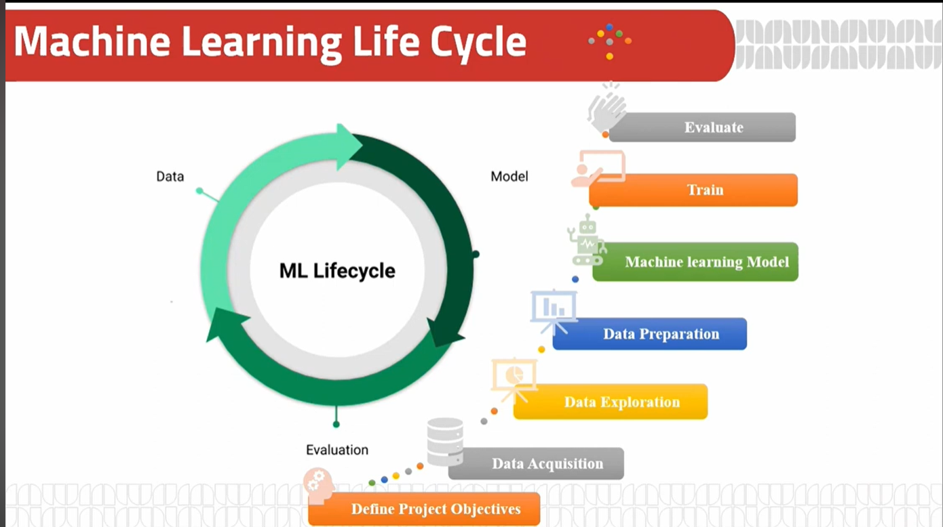

Slide 3



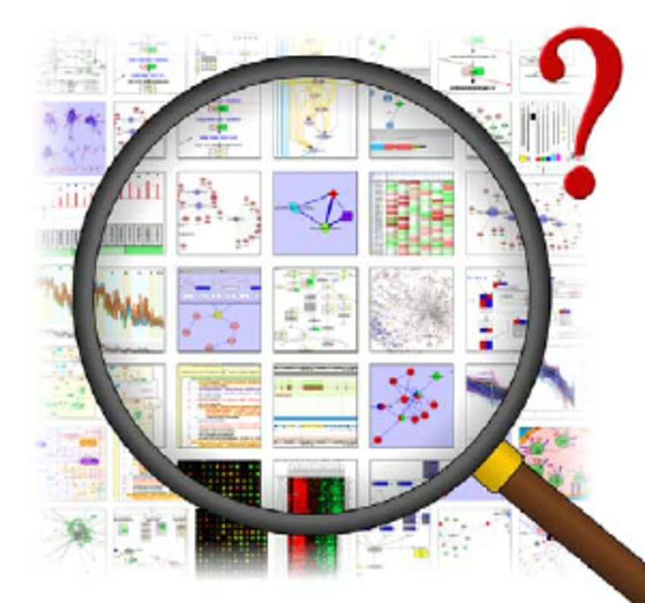

How to Data science:
Gathering and measuring information from countless different sources
Collecting data allows you to capture a record of past events so that we can use data analysis to find recurring patterns
Machine Learning Engineer
Use Machine Learning Techniques to build intelligent models to make useful predictions
Ask business –challenge-objective questions to recognize patterns ,draw conclusions ,visualizations and turns data into insights
Preparing (cleaning and organizing) the raw data and transforms it into an understandable and readable format
explore and visualize data to uncover insights from the start
Helps you to know the problems of your data
MLOps Engineer
Put the intelligent model in production to be actively use by consumers.
Data Collection
Explore Data (EDA)
Data Preprocessing
Data Understanding
Data Modeling
Model Deployment
Data Analyst
Data Engineer
Data Scientist
Notes:
Add activity to brainstorm in data science process before explain it.

Slide 4




What is Data
We are living in a data-driven economy. It’s a world
where having tons of data, understanding it and
knowing what to do with data is power.
Understanding your data is not one of the most difficult
things in data science, but it is time-consuming.
Interpretation of data is effective when we know about
the source of data.

Slide 5
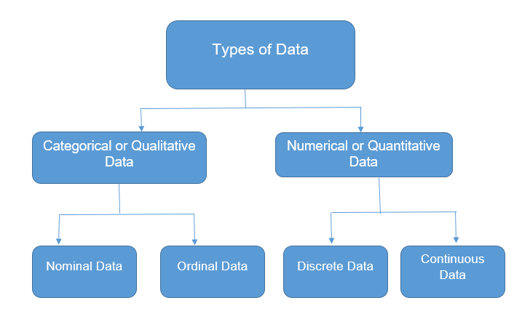
What is Data (Types of Data)
Categorical
This represents qualitative data with no apparent
inherent mathematical meaning.
Example: Yes or No, Sex, Race, Marital Status etc.
These can take be assigned numbers like Yes(1) and
No(0), but numbers have no mathematical meaning.
Numerical
This represents some sort of quantitative
measurement.
Example: height of people, stock price, page load time etc

Slide 6
What is Data (Numerical)
Discrete data
This is integer based, often counts of some event.
Example: “How many songs do a user like?” or
“How many times a coin flipped to “head” ?”
Continuous data
It has an infinite number of
possible values. Example: “How much time did it
take for a user to buy?”

Slide 7
What is Data (Categorical)
Nominal or unordered data
we assign individual items to named categories that do
not have an implicit or natural value or rank.
Example: Animals can be cats or dogs or horses etc..
that would be nominal data.
Ordinal or ordered data
items are assigned to categories that do have some kind
of implicit or natural order.
Example: “Small, Medium, or Large." Another example is a
survey question that asks us to rate an item on a 1 to 10
scale, with 10 being the best. This implies that 10 is better
than 9, which is better than 8, and so on.

Slide 8

The boy is fat,he is about 85kg and wearing a 2XL shirt
Qualitative,quatitative,ordinal
Quantative,qualitative, discrete
Qualitative,quantative, ordinal

Slide 9
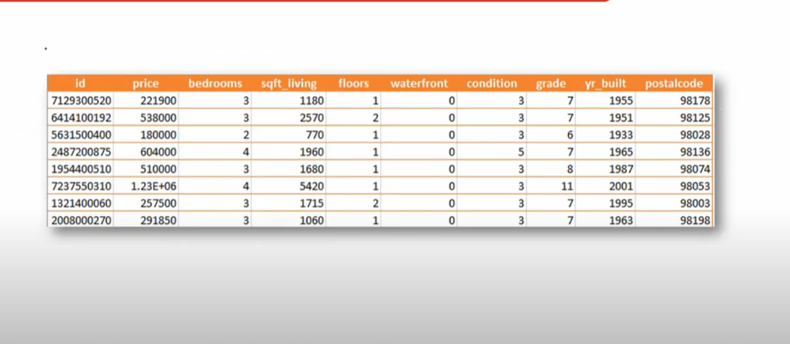

Slide 10
